Slide 1

DATA ANALYTICS FINAL TERM PROJECT
Machine Learning Applications In Predicting Rate Of Penetration (ROP) Using Drilling Parameters and Well Logs
Daniel Tetteh
April 29, 2021
PE 5970-005

Slide 2
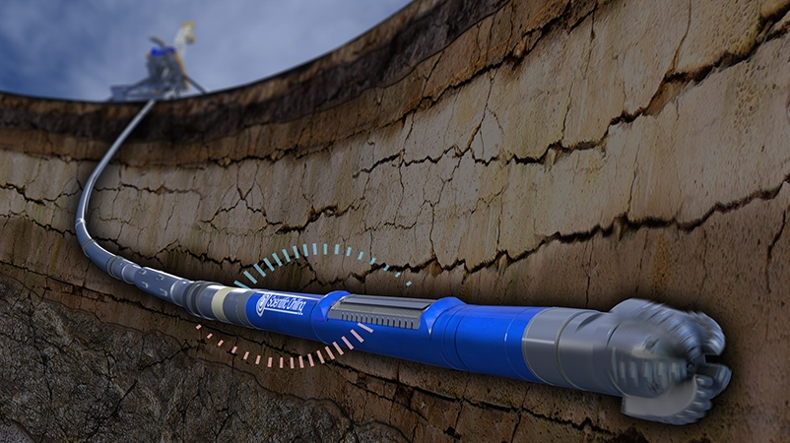

INTRODUCTION
RATE OF PENETRATION (ROP)
The speed at which the drill bit breaks the rock underneath to deepen the whole in a given formation.
The rate at which drill string penetrates the hole during drilling. (Li et al., 2019)
IMPORTANCE OF PREDICTING ROP
Accurate ROP prediction aids its optimization which reduces drilling time and thus the overall drilling cost
A good knowledge of ROP helps to identify;
formation fluid kicks
Over pressured and Under pressured drilling conditions
Drilling stick-slip (i.e. Torsional vibrations and associated energy release and absorptions) (Hegde et al., 2017)
A drill string in operation.
Source: https://tbrcinfo.wordpress.com/2017/08/02/geosteering-and-measurement-while-drilling-technologies-to-provide-real-time-data/

Slide 3
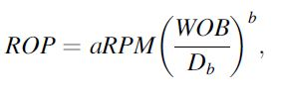
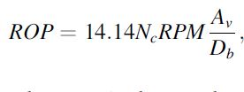
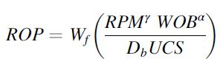
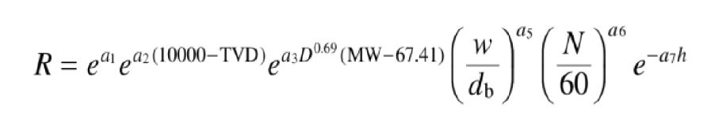
INTRODUCTION
SELECTED PHYSICS-BASED MODELS FOR ROP PREDICTION
Physics-based models exists for ROP prediction that make use of a number of input parameters.
These have a constant functionality between input parameters and ROP.
They have empirical coefficients that ought to be tuned via training for different lithology.
Model Name | Equation | Parameters
Bingham’s Model (Bingham, 1965) |  | Weight on Bit (WOB), Rotation per Minute (RPM), bit diameter D_{b ;} a and b =empirical constants
2. Hareland’s Model (Hareland and Rampersad, 1994) |  | RPM, Number of bit cutters (Nc), Area of rock compressed ahead of cutters (Av) in square inch
3.Motahhari’s Model (Motahhari et al., 2010) |  | RPM, WOB, Unconfined Rock Strength (UCS), bit diameter, Bit Wear function (W_{f}), α and γ are model exponents
4. Bourgoyne and Young's Model (Bourgoyne and Young, 1972) |  | A complex model based on formation strength, bottom hole pressure differential, WOB,RPM, bit wear, bit hydraulics, rock compaction, equivalent circulation density of drilling fluid, density of drilling fluid

Slide 4
INTRODUCTION
LIMITATIONS OF PHYSICS-BASED ROP PREDICTION MODELS
They are not adaptable and empirical coefficients requires modification for every formation.
Surface and downhole boundary conditions are not properly described in application of physics based models
Some of the parameters employed in ROP predictions may be affected by human error (eg. Bit wear as seen in Bourgoyne and Young's Model) (Li and Samuel. 2019)
Accuracies or these models are fairly low (Hegde and Gray, 2017)
Accurate modelling using these models is often compromised due to unknown or insufficient knowledge of parameters
ADVANTAGES OF MACHINE LEARNING MODELS OVER PHYSICS-BASED MODELS
Functional relationship between input parameters and ROP is generated from well data and not fixed (as in physics-based models).
Are not dependent on empirical coefficients
Model does not necessarily require retraining for similar lithology (Hegde and Gray, 2017). Retraining may however improve accuracy.
Data-driven models are more accurate and usually give higher R2 values. (Hegde et al., 2017)

Slide 5

INTRODUCTION
DATA SOURCE AND DESCRIPTION
Utah Forge Field
Well 58-32 (MU-ESW1)
About 5000 data points
Surface Drilling Parameters data obtained
Weight on Bit (WOB)
Rate of Penetration (ROP)
Standpipe Pressure (SPP)
Drilling Torque (TORQ)
Drilling String RPM
Mud flowrate
Well Log Data
Gamma Ray (GR)
Bulk Density Porosity (DPHZ)
Neutron Porosity (NPOR)
Source: https://gdr.openei.org/search?sort=relevance&size=25&availability=&q=Utah+Forge+Field+Well+58-32

Slide 6
OBJECTIVES
Construct MODEL 1-- A regression model to predict ROP with drilling parameters as inputs (without lithology)
Machine Learning Algorithms
K-Nearest Neighbors
Random Forest
Multilayer Perceptron
Select the best model based on performance of algorithms
Classification: Cluster data points into different lithology using Well Logs data via unsupervised clustering.
Machine Learning Algorithms used
K-Means Clustering
Hierarchical Clustering
Construct MODEL 2-- A regression model to predict ROP with drilling parameters and lithology (cluster labels)
Machine Learning Algorithms (Same for Model 1 construction)
Select best model based on performance of algorithms
Compare MODEL 1 and MODEL 2

Slide 7
WORKFLOW
Data Preprocessing-Cleaning and Scaling
Supervised Learning-Regression (KNN, Random Forest, MLP)
Unsupervised Learning- Classification (KMeans and Hierarchical Clustering)
Supervised Learning-Regression (KNN, Random Forest, MLP)
Comparison of Results and Conclusions

Slide 8
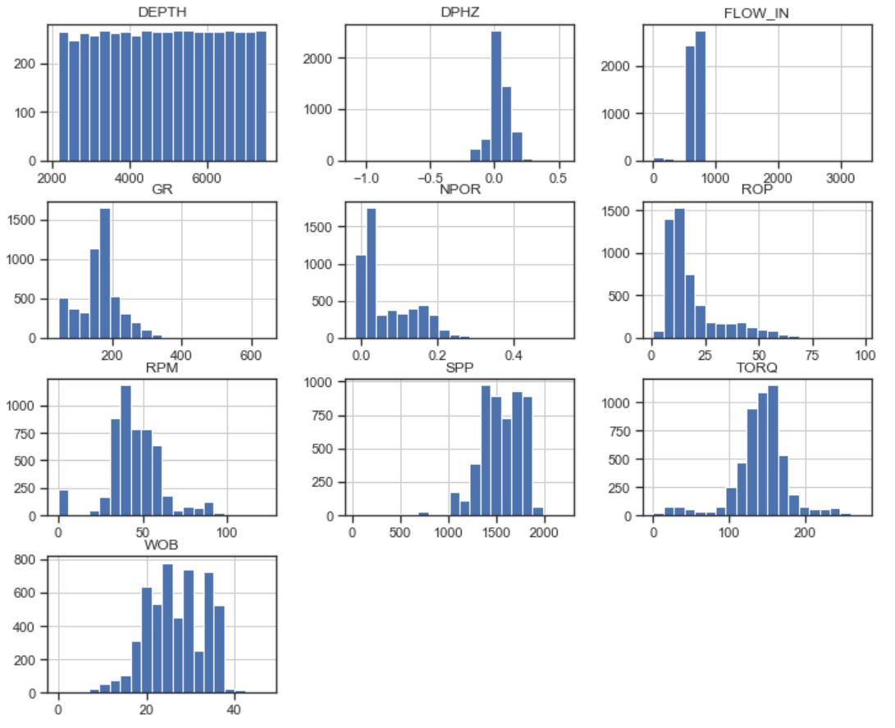
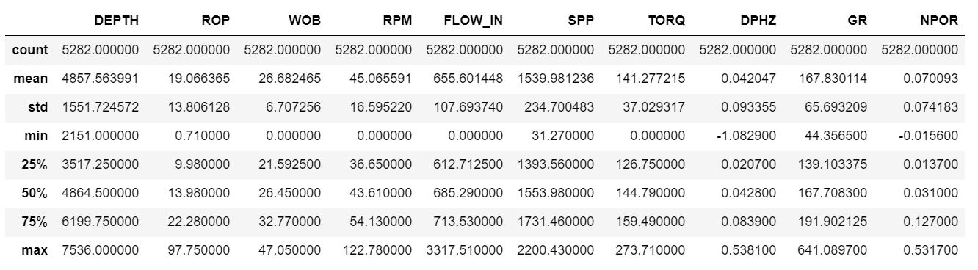

DATA PREPROCESSING
ORIGINAL DATA
Number of Rows | Number of Columns
5828 | 10
No Missing Data

Slide 9
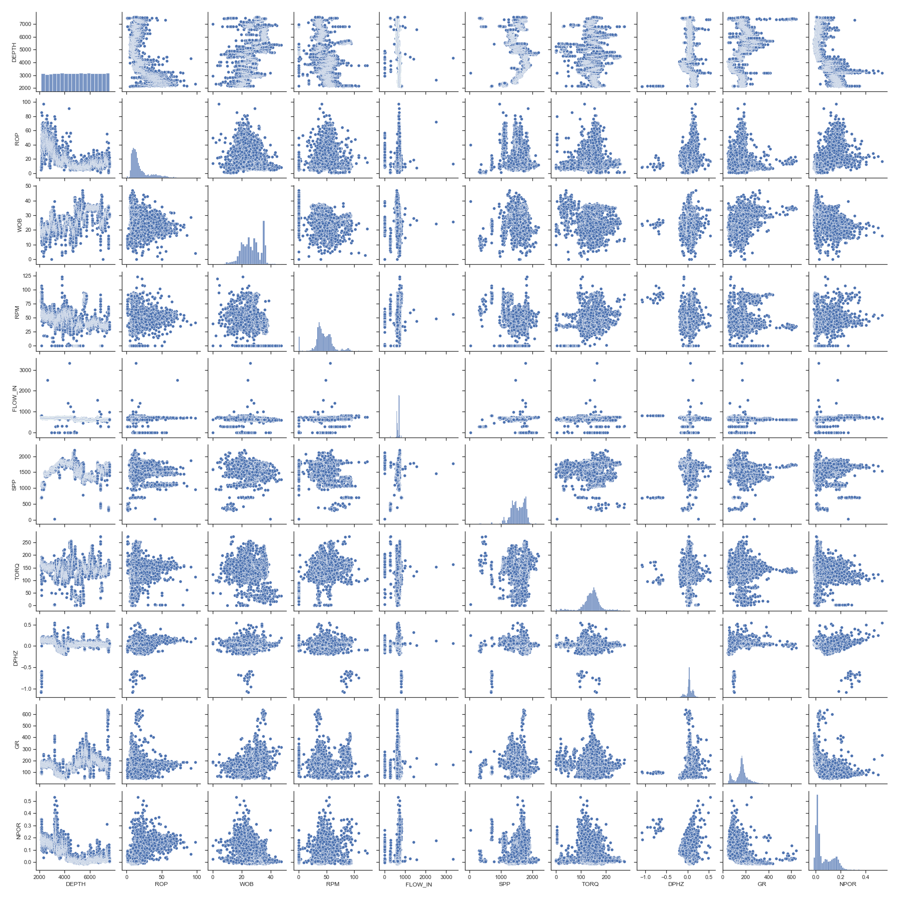
DATA PREPROCESSING
DATA VISUALIZATION
Original Dataset
Matrix scatter plot of entire data set showing significant outliers

Slide 10
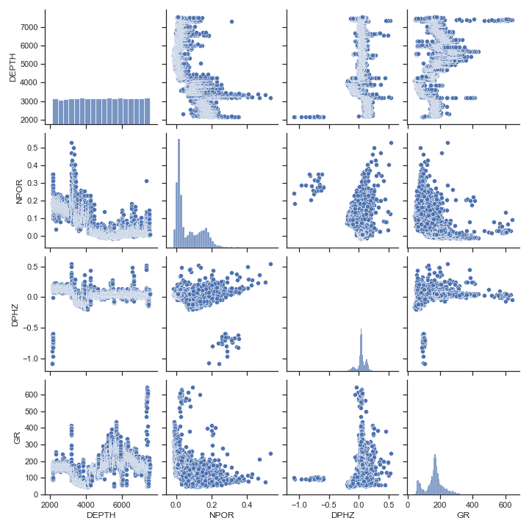
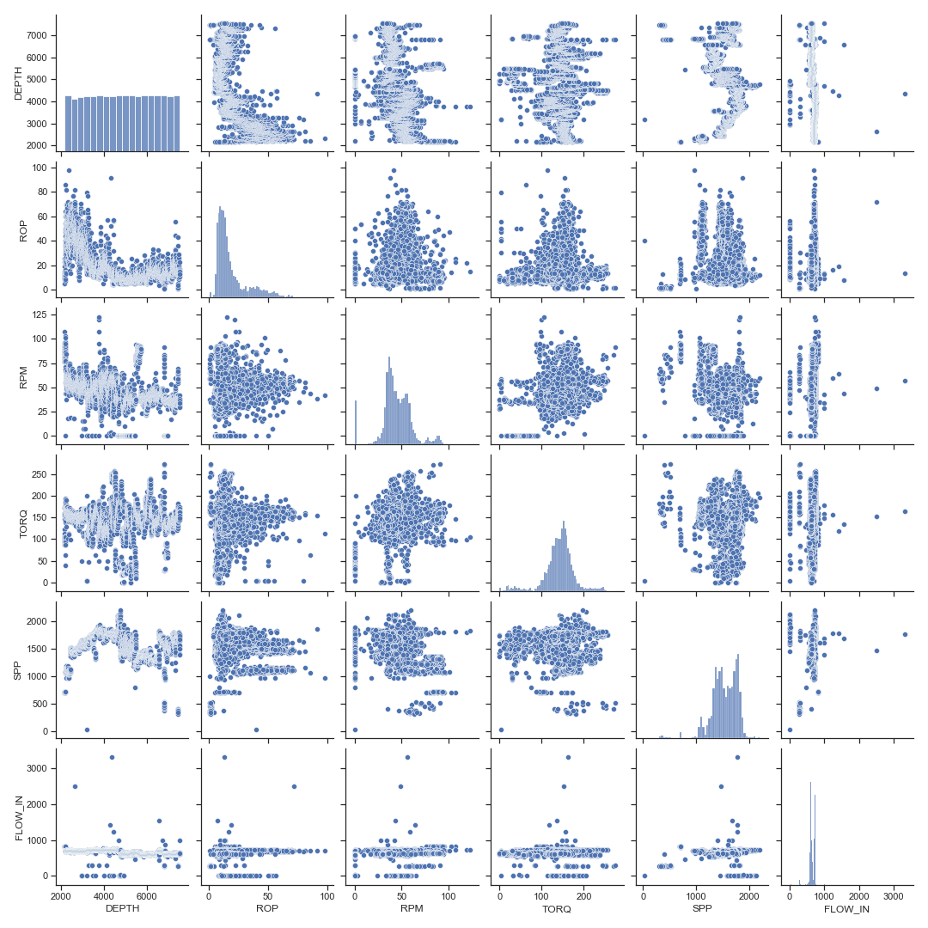
DATA PREPROCESSING
MATIX SCATTER PLOTS
Well Logs plotted separately
Drilling Parameters plotted separately

Slide 11
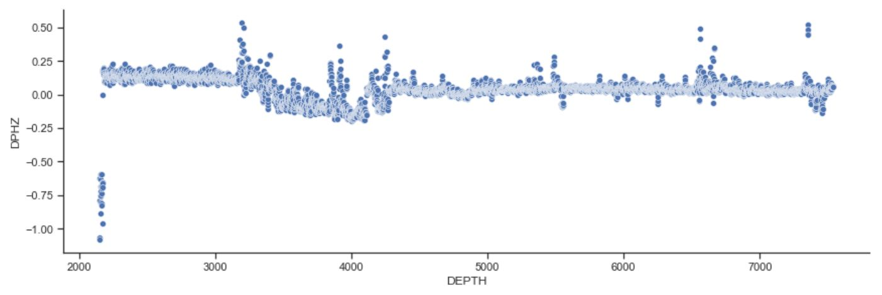
DATA PREPROCESSING
OUTLIER REMOVAL
Zones with densities greater than that of limestone show negative bulk density porosity values (Kansas Geological Survey)
(http://www.kgs.ku.edu/Publications/Bulletins/LA/04_nuclear.html)
Regions with DPHZ< -0.4 and GR> 250 API units were removed
The Z-score outlier detection and removal was used to further remove significant outliers as seen in matrix scatter plots.

Slide 12
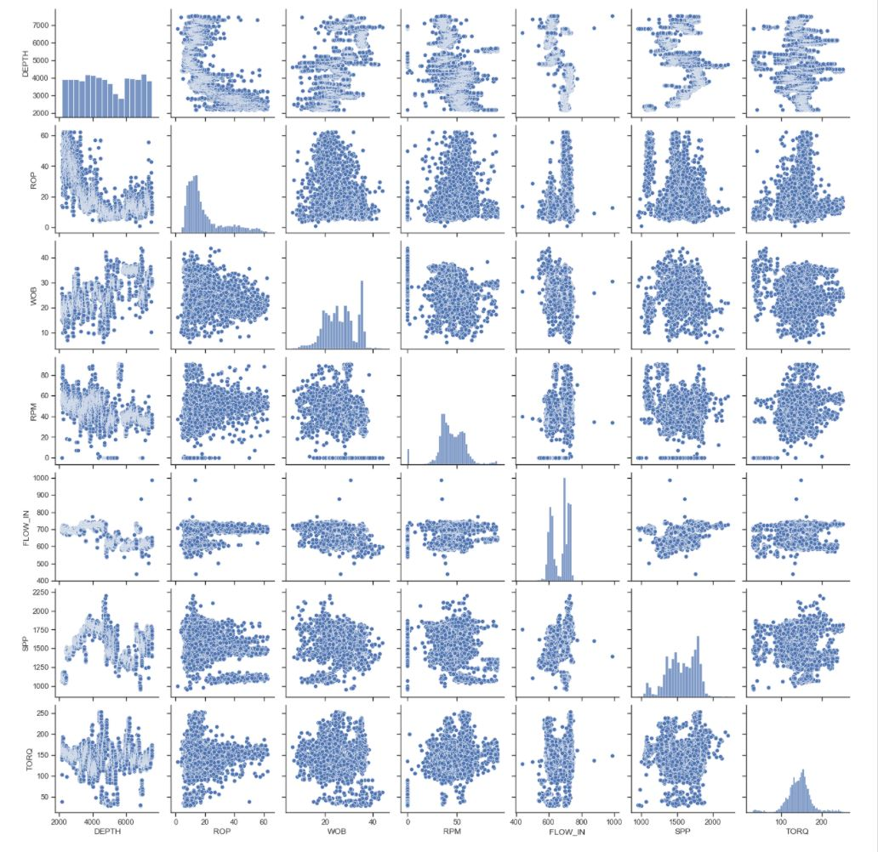
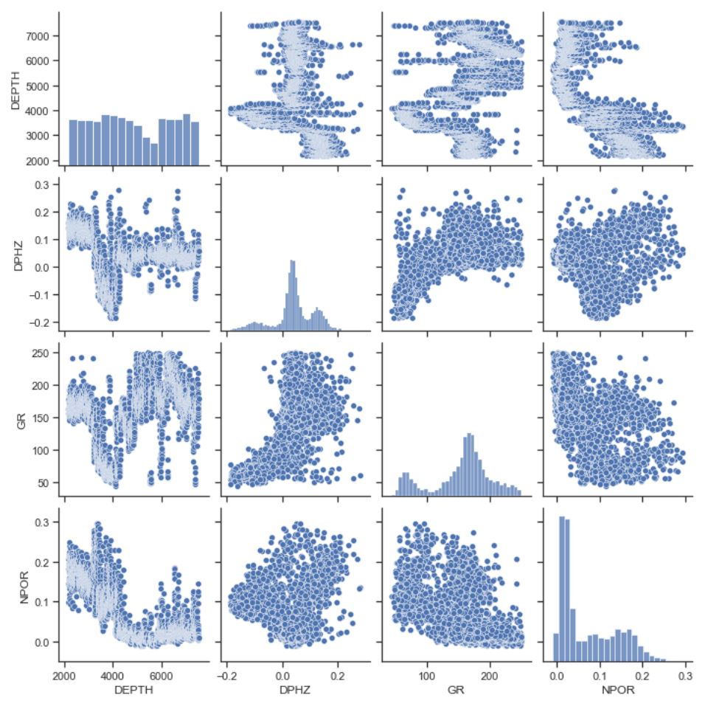
DATA PREPROCESSING
MATRIX SCATTER PLOTS FOR CLEANED DATA
Final shape after outlier removal | Number of Rows | Number of Columns | No Missing Values were recorded
 | 4430 | 10
Cleaned Well Logs
Cleaned Drilling Parameters

Slide 13
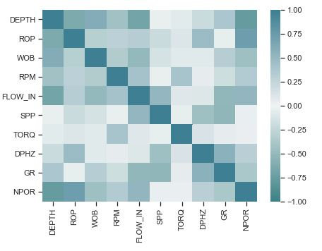
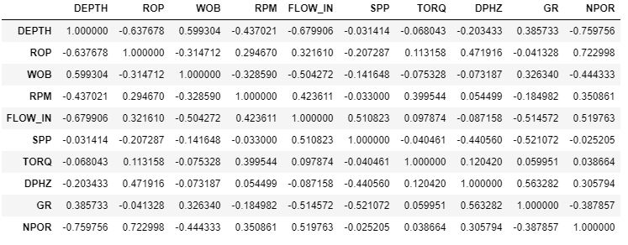
DATA PREPROCESSING
Looked at some initial correlations between the parameters

Slide 14
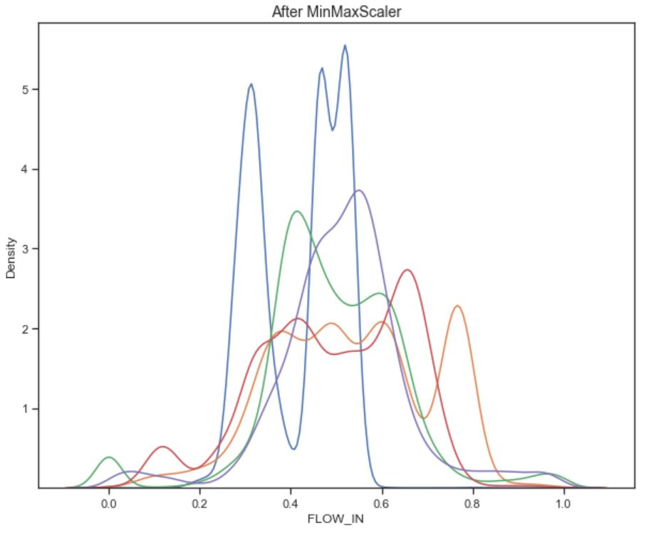
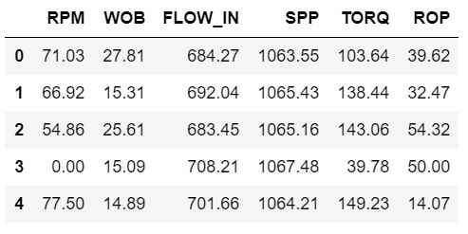
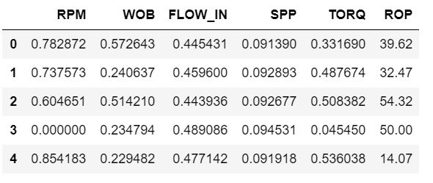
DATA PREPROCESSING
SCALING DRILLING PARAMETERS
Minimax Scaler was used in scaling drilling Parameters
All Drilling Parameters with the exception of the predicted parameter (ROP) were scaled.
Drilling Parameters before Scaling
There were no missing Values after Scaling
Drilling Parameters after Scaling

Slide 15
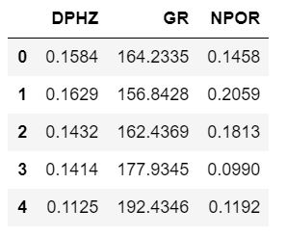
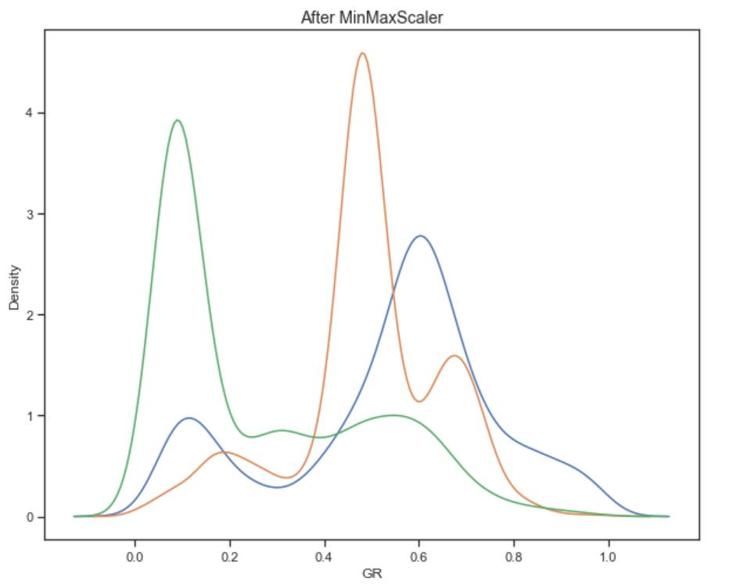
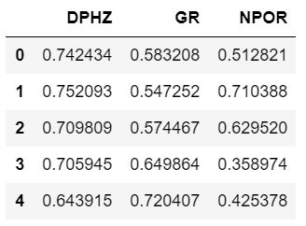
DATA PREPROCESSING
SCALING WELL LOGS
Minimax Scaler was used in scaling Well Logs
Well Logs before Scaling
There were no missing Values after Scaling
Well logs after Scaling

Slide 16
SUPERVISED LEARNING
Output Parameter
Construct a regression model to predict ROP using drilling parameters as inputs: i.e. SPP, WOB, RPM, FLOW_IN, TORQ
Machine Learning algorithms used
K-Nearest Neighbors
Random Forest
Multilayer Perceptron (MLP)
Train/ Test split was done
85% of the data was used for training
15% was used for testing
Labels
X_train-Training input data
Y-train-Training output data
X_test-Test input data
Y_test-Test output data
 | Number of Rows | Number of Columns
X_train | 3765 | 5
Y_train | 3765 | 1
X_test | 665 | 5
Y_test | 665 | 1

Slide 17
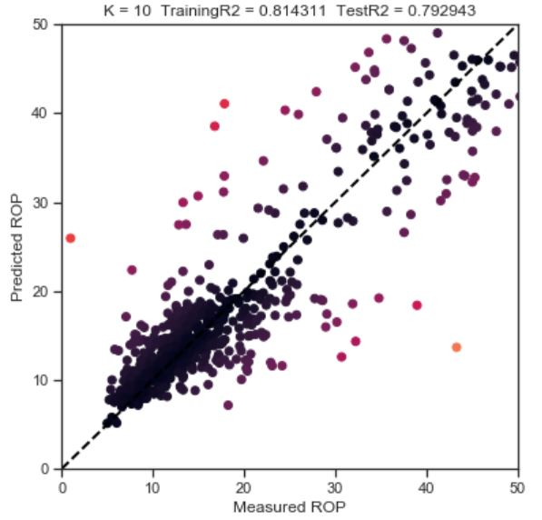
SUPERVISED LEARNING
K-Nearest Neighbors (With Hyperparameter Optimization)
Hyperparameter Optimization
All other parameters were kept at default and n_neighbours (k) was varied
K | Training R2 | Test R2 | RMSE
10 | 0.814311 | 0.792943 | 5.94063
20 | 0.774063 | 0.754702 | 6.46598
30 | 0.749095 | 0.729057 | 6.79557
40 | 0.731282 | 0.716680 | 6.94907
50 | 0.718765 | 0.705114 | 7.08949
60 | 0.708144 | 0.693667 | 7.22578
70 | 0.698085 | 0.687533 | 7.29777
80 | 0.688535 | 0.6820484 | 7.36111
90 | 0.678415 | 0.6754467 | 7.43758
Best model slightly overfits but has the lowest RMSE

Slide 18
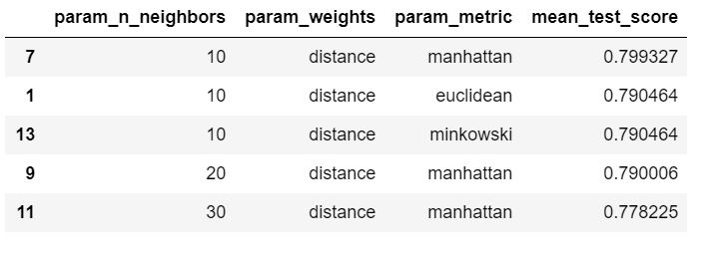
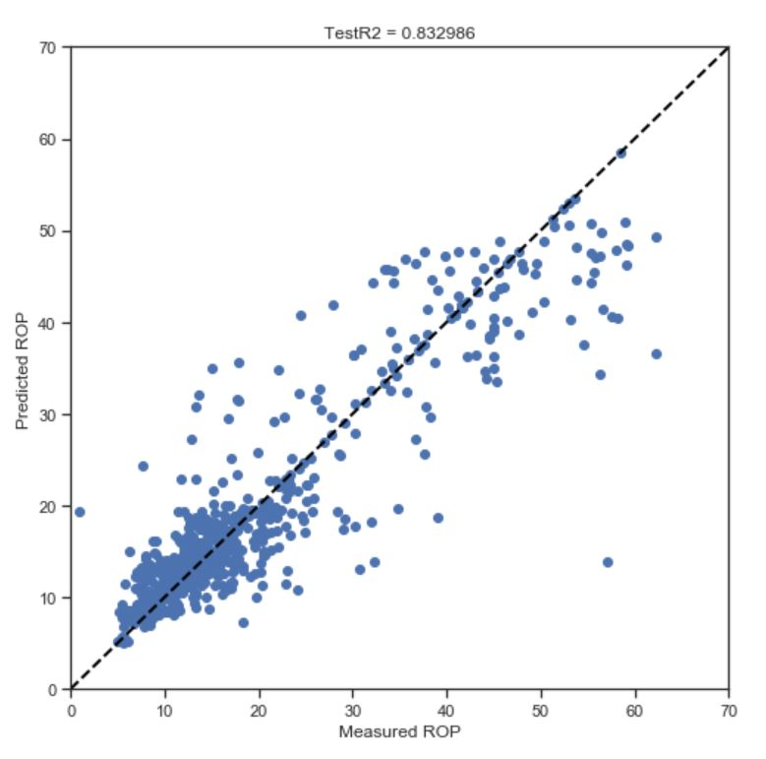
SUPERVISED LEARNING
K-Nearest Neighbors (With Cross-Validation)
5-FOLD CROSS-VALIDATION HYPERPARAMETERS
n_neighbors (k) | Weights | Metric
10,20,30 | Uniform, distance | Euclidean, Manhattan, Minkowski
Cross-validation top 5 estimators based on mean test score
Best Estimator Metrics
Training R2 | 0.799327
Test R2 | 0.832986
RMSE | 5.33536

Slide 19
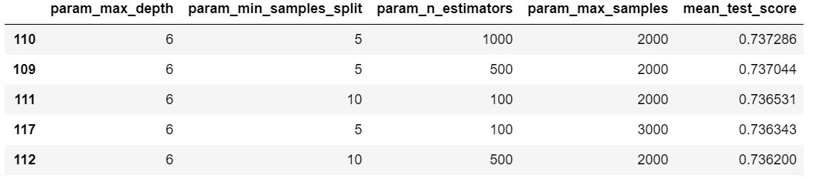
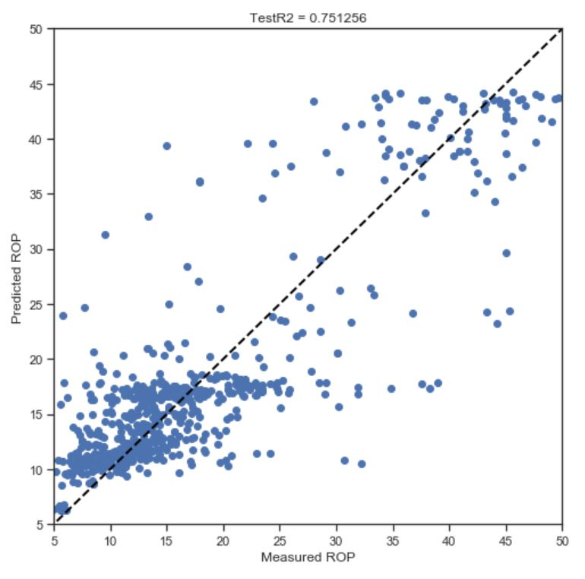
SUPERVISED LEARNING
Random Forest (With Cross-Validation)
10-FOLD CROSS-VALIDATION HYPERPARAMETERS
Bootstrap | Max_depth | min_samples_split | n_estimators | max_samples
True | 3,4,5,6 | 5,10,15 | 100, 500, 1000 | 2000, 3000, 4000, 5000
Cross-validation top 5 estimators based on mean test score
Best Estimator Metrics
Training R2 | 0.737286
Test R2 | 0.751255
RMSE | 6.51125

Slide 20
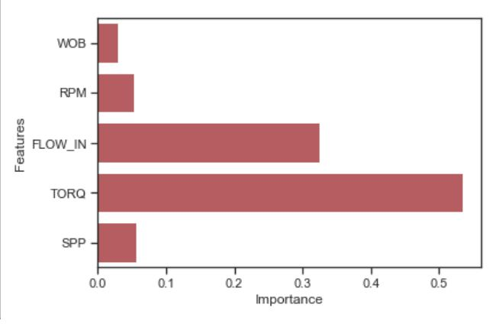
SUPERVISED LEARNING
Random Forest (Feature Importances)
Created a new input data set with TORQ and FLOW_IN
 | Number of Rows | Number of Columns
X1_train | 3765 | 2
Y1_train | 3765 | 1
X1_test | 665 | 2
Y1_test | 665 | 1
Metrics of Model with Important Features
Training R2 | 0.61363956
Test R2 | 0.55689984
Other features contribution significantly affected ROP prediction

Slide 21
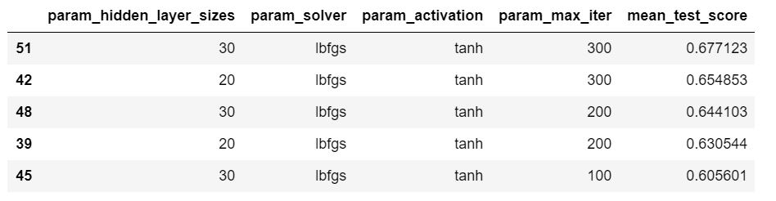
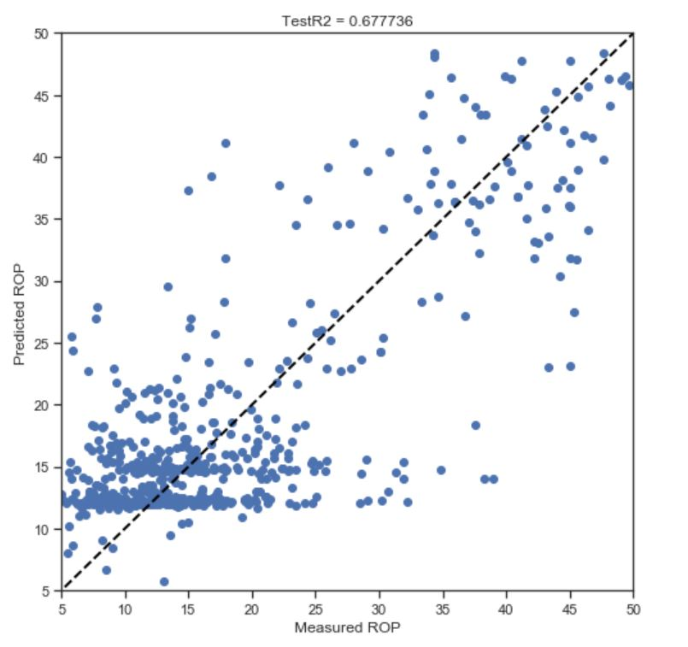
SUPERVISED LEARNING
MLP (With Cross-Validation)
10-FOLD CROSS-VALIDATION HYPERPARAMETERS
hidden_layer_sizes | solver | activation | max_iter
10, 20, 30 | lbfgs,sgd, adam | identity, tanh, relu | 100,200,300
Cross-validation top 5 estimators based on mean test score
Best Estimator Metrics
Training R2 | 0.677123
Test R2 | 0.677736
RMSE | 7.41129

Slide 22

SUPERVISED LEARNING
COMPARING ALL SUPERVISED LEARNING MODELS FOR MODEL 1 CONSTRUCTION
NO. | ML ALGORITHM | PARAMETERS | TRAINING R2 | TEST R2 | RMSE
1 | K-Nearest Neighbors (varying K and keeping all other parameters default) | n_neighbours=10; weights=uniform; Metric= Minkowski; (all other parameters set default) | 0.814311 | 0.792943 | 5.94063
2 | KNN (best estimator after cross-validation) | n_neighbours=10; weights=distance; Metric= Manhattan; (all other parameters set default) | 0.799327 | 0.832986 | 5.33536
3 | Random Forest (best estimator after cross-validation) | Max_depth=6; min_samples_split=5; n_estimators=1000; max_samples= 2000 (all other parameters set default) | 0.737286 | 0.751255 | 6.51125
4 | Multi-Layer Perceptron (MLP) (best estimator after cross-validation) | hidden_layer_sizes=30; solver=lbfgs; activation=tanh; max_iter=300 (all other parameters set default) | 0.677123 | 0.677735 | 7.41129

Slide 23
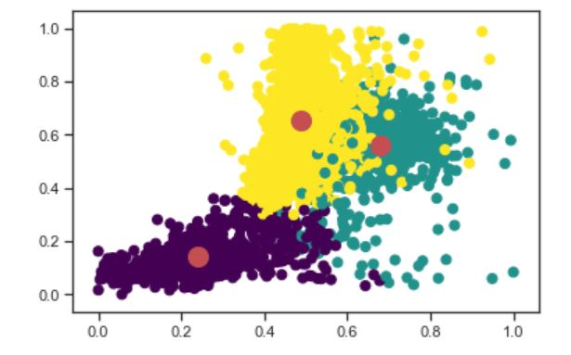
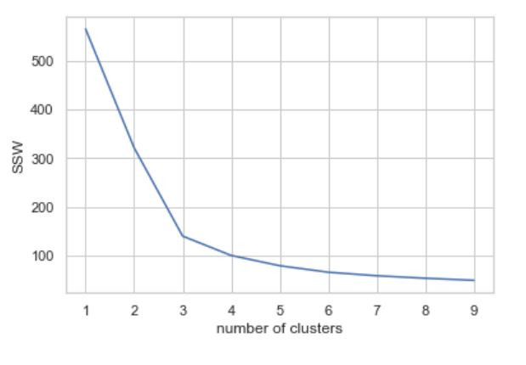
UNSUPERVISED LEARNING
KMEANS CLUSTERING
MODEL PARAMETERS
n_clusters | init | n_init | max_iter
3 | k-means++ | 10 | 300
Scaled Input Features
Optimal number of clusters= 3

Slide 24
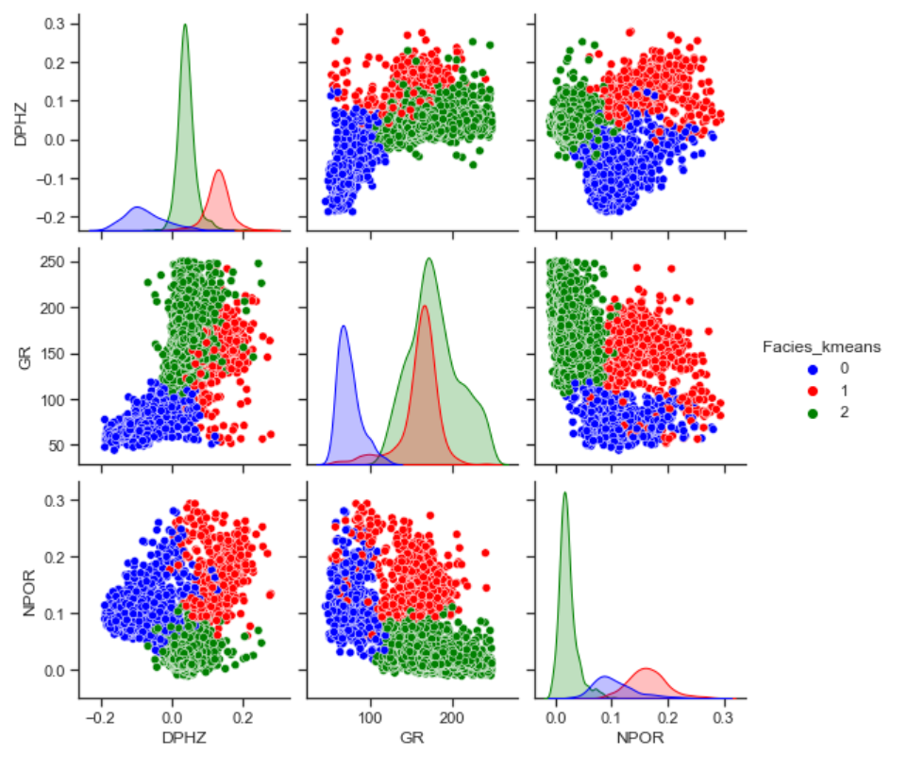
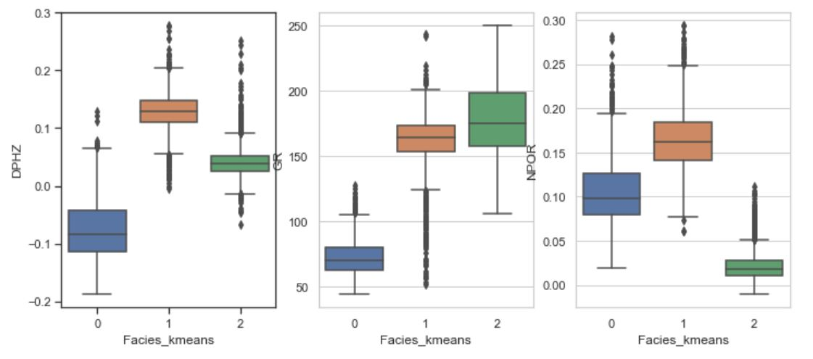
UNSUPERVISED LEARNING
KMEANS CLUSTERING
Datapoints are well clustered; boxplots show minimal overlaps.
Data points in cluster label 2 have high GR values with relatively low bulk density and neutron porosities; possibility of a highly shaly zone
Datapoints in cluster 1 have relatively good DPHZ and NPOR values

Slide 25
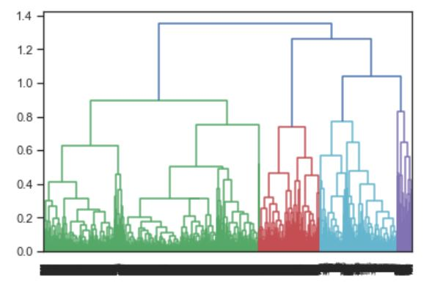
UNSUPERVISED LEARNING
HIERACHICHAL CLUSTERING
MODEL PARAMETERS
n_clusters | affinity | Linkage
3 | euclidean | ward
Dendogram

Slide 26
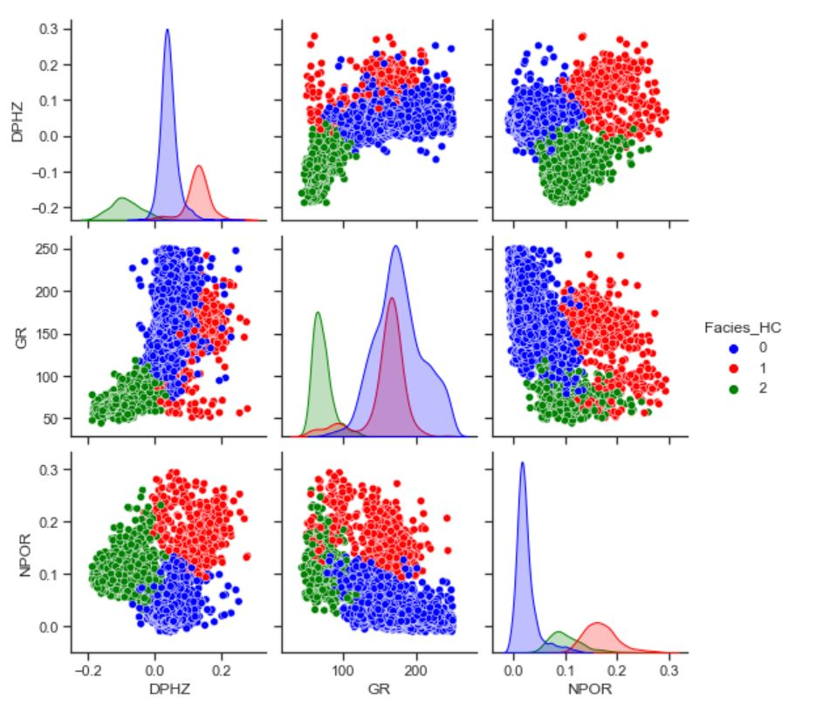
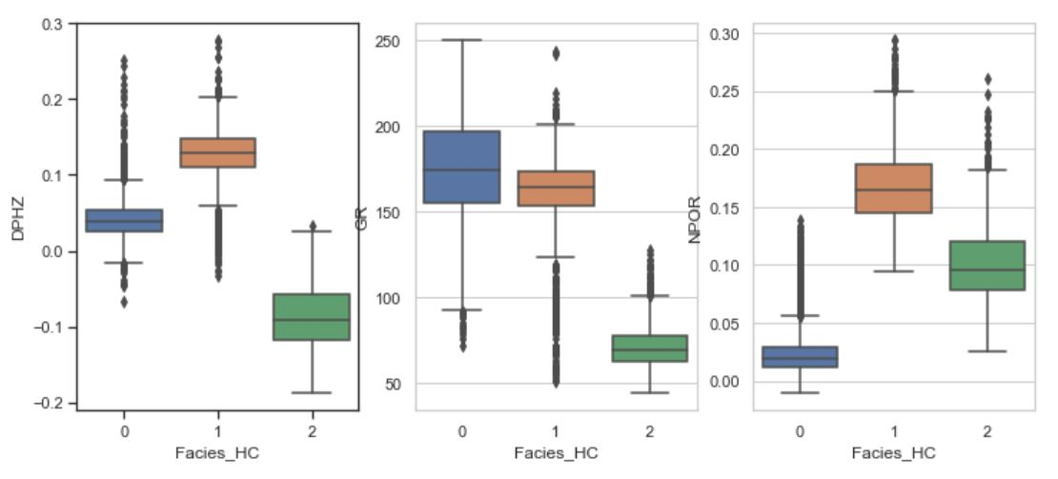
UNSUPERVISED LEARNING
HIERARCHICHAL CLUSTERING
Hierarchical Clustering performed similarly to KMeans

Slide 27
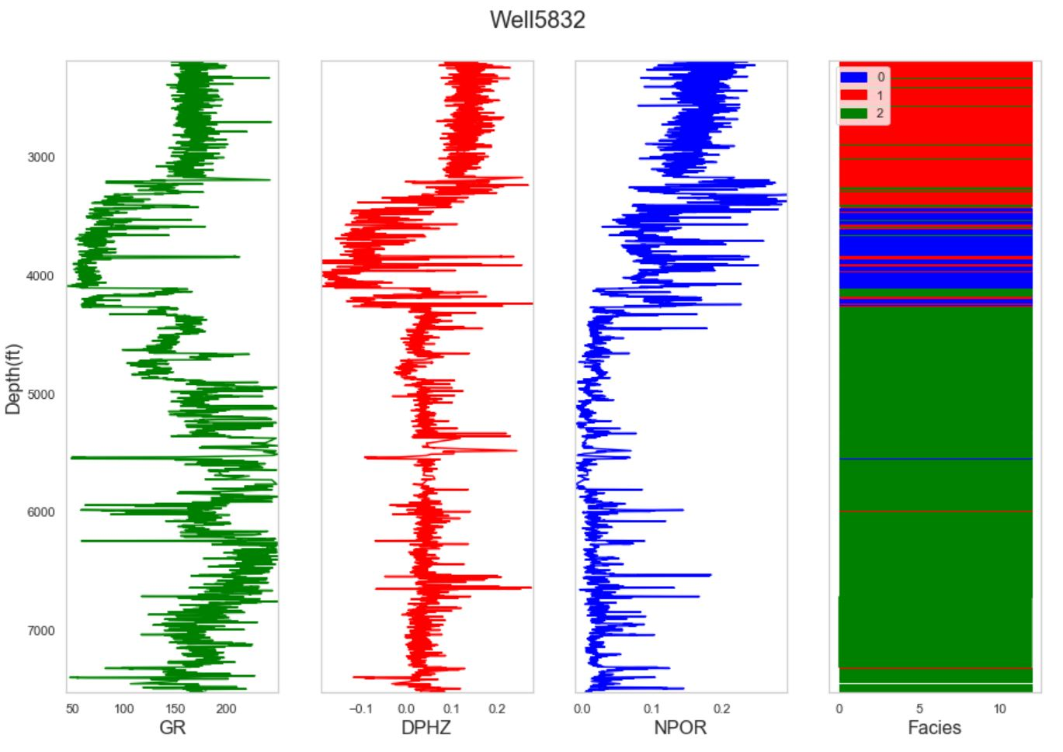
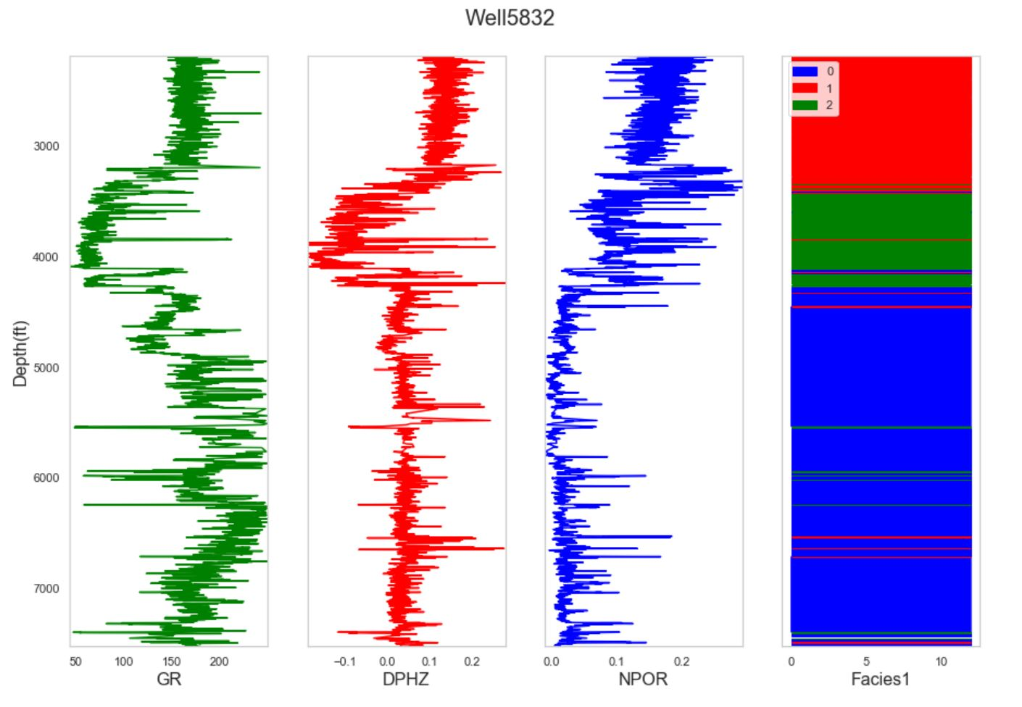
UNSUPERVISED LEARNING
COMPARING CLUSTERS AGAINST DEPTH
K-Means Clustering
Hierarchical Clustering

Slide 28
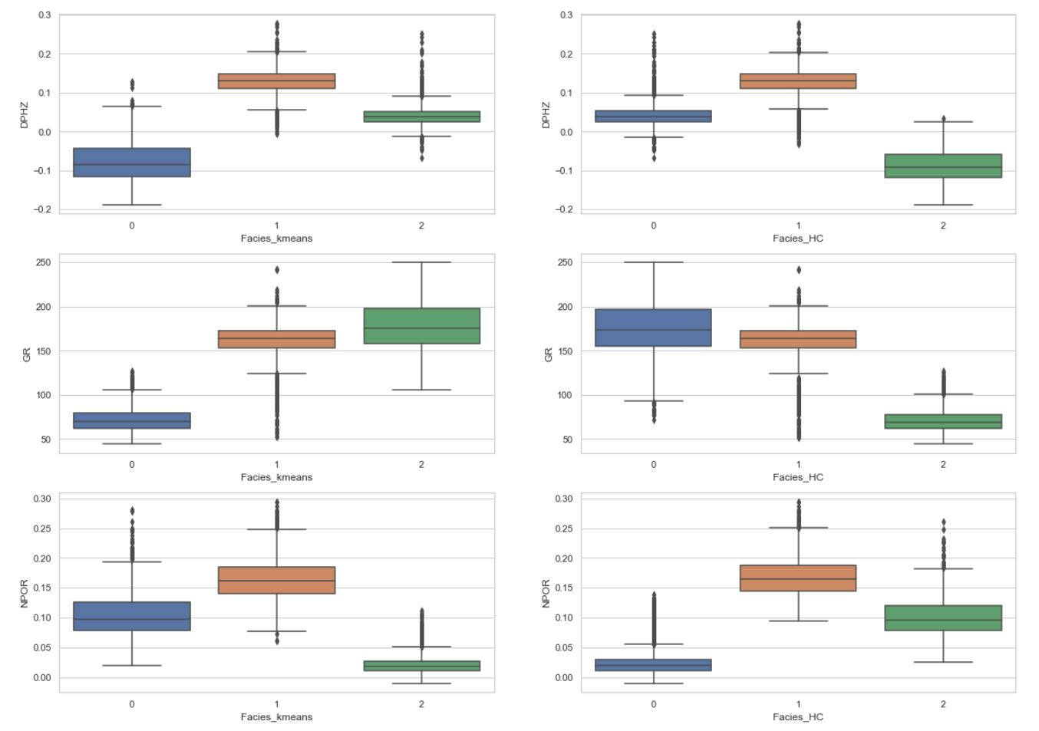
UNSUPERVISED LEARNING
COMPARING CLUSTERS BASED ON BOX PLOTS
KMeans and Hierarchical Clustering performed similarly
Group of points labeled 0 by KMeans is labelled 2 by Hierarchical Clustering
Can be inferred that region between about 3100ft to about 4000ft is predominantly a region with high gamma ray.

Slide 29
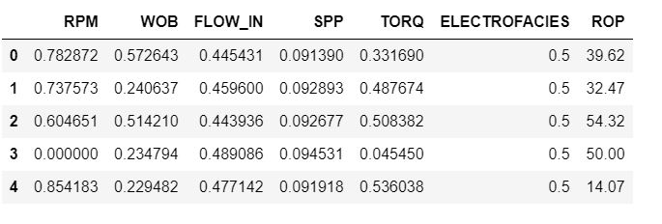
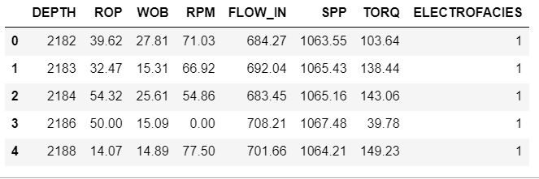
SUPERVISED LEARNING (2)
Reconstruct regression models using KMeans cluster label (lithology) as on of the input parameters. Thus the inputs are: i.e. SPP, WOB, RPM, FLOW_IN, TORQ, ELECTROFACIES
ELECTROFACIES= KMeans Cluster Labels
Same Machine Learning algorithms are used as in Model 1 construction
Train/ Test split
85% of the data was used for training
15% was used for testing
Labels
X2_train-Training input data
Y2-train-Training output data
X2_test-Test input data
Y2_test-Test output data
Output Parameter
After Scaling
 | Number of Rows | Number of Columns
X2_train | 3765 | 6
Y2_train | 3765 | 1
X2_test | 665 | 6
Y2_test | 665 | 1
Before Scaling

Slide 30
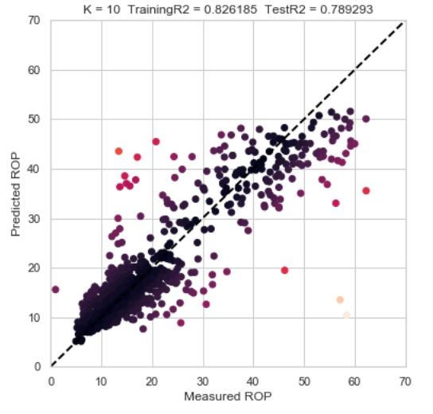
SUPERVISED LEARNING (2)
K-Nearest Neighbors (With Hyperparameter Optimization)
Hyperparameter Optimization
All other parameters were kept at default and n_neighbours (k) was varied
K | Training R2 | Test R2 | RMSE
10 | 0.826185 | 0.789293 | 5.88231
20 | 0.794942 | 0.772339 | 6.11438
30 | 0.778998 | 0.759503 | 6.28439
40 | 0.764803 | 0.750589 | 6.39980
50 | 0.755644 | 0.743857 | 6.48559
60 | 0.748445 | 0.740339 | 6.52998
70 | 0.742834 | 0.735442 | 6.59126
80 | 0.737528 | 0.730861 | 6.64809
90 | 0.732917 | 0.728088 | 6.68225
Best model slightly underfits but has the lowest RMSE

Slide 31
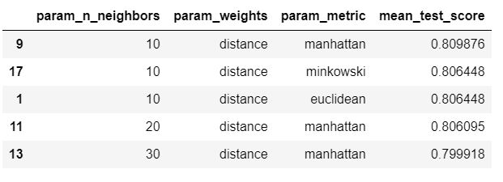
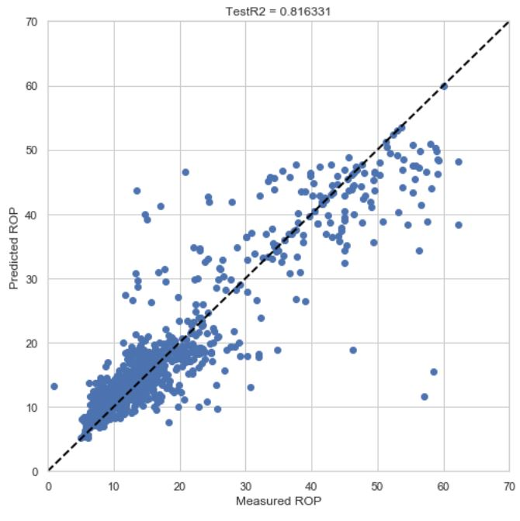
SUPERVISED LEARNING (2)
K-Nearest Neighbors (With Cross-Validation)
5-FOLD CROSS-VALIDATION HYPERPARAMETERS
n_neighbors (k) | Weights | Metric
10, 20, 30, 40 | Uniform, distance | Euclidean, Manhattan, Minkowski
Cross-validation top 5 estimators based on mean test score
Best Estimator Metrics
Training R2 | 0.809876
Test R2 | 0.816331
RMSE | 5.491942

Slide 32
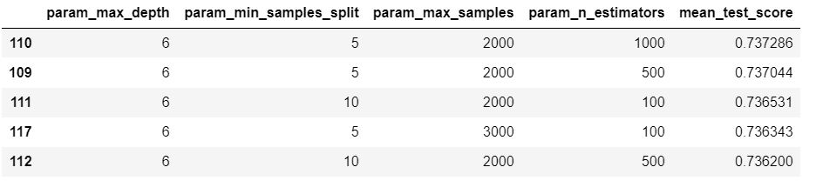
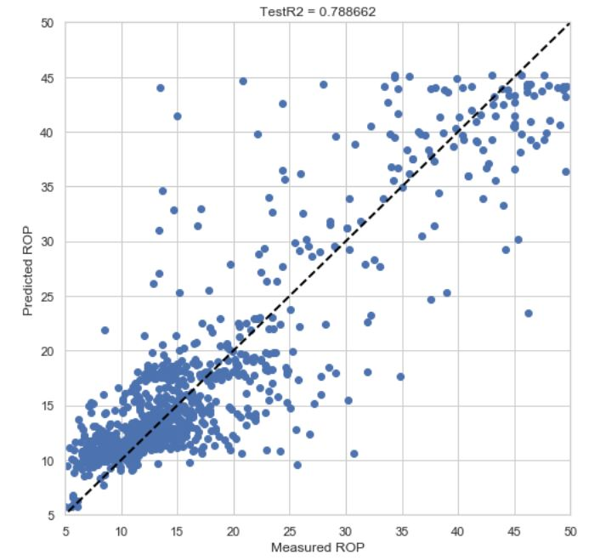
SUPERVISED LEARNING (2)
Random Forest (With Cross-Validation)
10-FOLD CROSS-VALIDATION HYPERPARAMETERS
Bootstrap | Max_depth | min_samples_split | n_estimators | max_samples
True | 5,6,7 | 5,10,15 | 500, 1000 | 2000, 3000, 4000
Cross-validation top 5 estimators based on mean test score
Best Estimator Metrics
Training R2 | 0.737286
Test R2 | 0.788661
RMSE | 5.891114

Slide 33
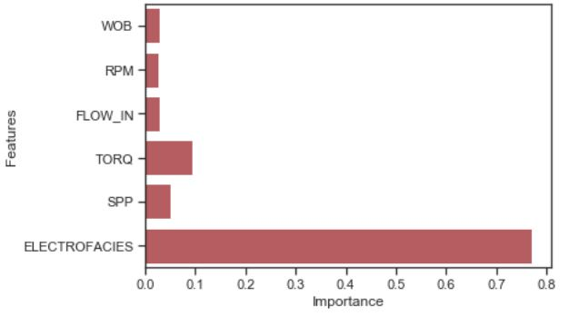
SUPERVISED LEARNING(2)
Random Forest (Feature Importances)
Created a new input data set with TORQ and SPP and ELECTROFACIES
 | Number of Rows | Number of Columns
X3_train | 3765 | 3
Y3_train | 3765 | 1
X3_test | 665 | 3
Y3_test | 665 | 1
Metrics of Model with Important Features
Training R2 | 0.7947614
Test R2 | 0.7425720
RMSE | 6.6239300
Using important features improved the Training R2 but not the Test R2 and the RMSE

Slide 34
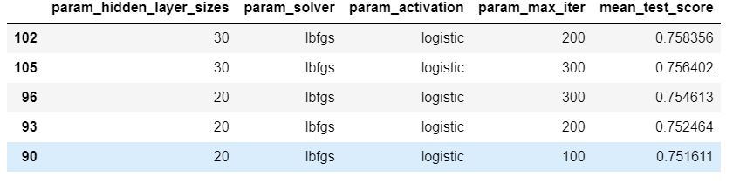
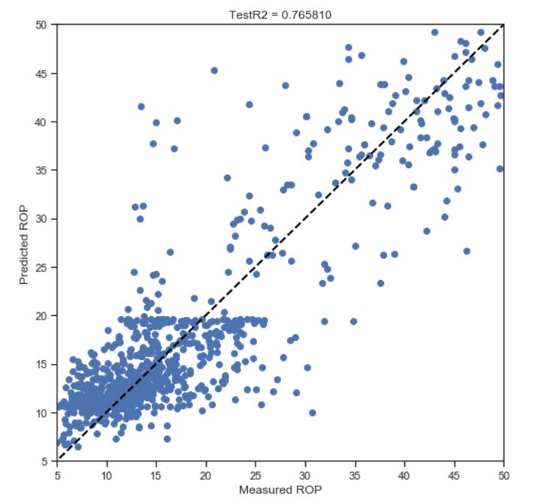
SUPERVISED LEARNING (2)
MLP (With Cross-Validation)
10-FOLD CROSS-VALIDATION HYPERPARAMETERS
hidden_layer_sizes | solver | activation | max_iter
10, 20, 30 | lbfgs,sgd, adam | identity, tanh, relu | 100,200,300
Cross-validation top 5 estimators based on mean test score
Best Estimator Metrics
Training R2 | 0.758356
Test R2 | 0.765810
RMSE | 6.201441

Slide 35

SUPERVISED LEARNING (2)
COMPARING ALL SUPERVISED LEARNING MODELS FOR MODEL 2 CONSTRUCTION
NO. | ML ALGORITHM | PARAMETERS | TRAINING R2 | TEST R2 | RMSE
1 | K-Nearest Neighbors (varying K and keeping all other parameters default) | n_neighbours=10; weights=uniform; Metric= Minkowski; (all other parameters set default) | 0.826185 | 0.789293 | 5.88231
2 | KNN (best estimator after cross-validation) | n_neighbours=10; weights=distance; Metric= Manhattan; (all other parameters set default) | 0.809876 | 0.816331 | 5.49194
3 | Random Forest (best estimator after cross-validation) | Max_depth=6; min_samples_split=5; n_estimators=100 ; max_samples= 2000 (all other parameters set default) | 0.737286 | 0.788662 | 5.89111
4 | Multi-Layer Perceptron (MLP) (best estimator after cross-validation) | hidden_layer_sizes=30; solver=lbfgs; activation=logistic; max_iter=200 (all other parameters set default) | 0.758356 | 0.76581 | 6.20144

Slide 36
CONCLUSION
COMPARING MODELS
For the given data set, K Nearest Neighbors showed a better ability at predicting ROP from the given input features compared to the other algorithms used
Both KMeans and Hierarchical Clustering Performed Similarly Good in Clustering Well Logs
Including the KMeans labels (Lithology) as input in construction of Model 2 improved the Training R2 of almost all the ML algorithms and reduced the RMSE but had no significant effect on the Test R2

Slide 37
REFERENCES
1. | Hegde, C., Daigle, H., Millwater, H., & Gray, K. (2017). Analysis of rate of penetration (ROP) prediction in drilling using physics-based and data-driven models. Journal of Petroleum Science and Engineering, 159, 295-306.
2. | Hegde, C., & Gray, K. E. (2017). Use of machine learning and data analytics to increase drilling efficiency for nearby wells. Journal of Natural Gas Science and Engineering, 40, 327-335.
3. | Li, Y., & Samuel, R. (2019, March). Prediction of penetration rate ahead of the bit through real-time updated machine learning models. In SPE/IADC International Drilling Conference and Exhibition. Society of Petroleum Engineers.
4. | Al-AbdulJabbar, A., Elkatatny, S., Abdulhamid Mahmoud, A., Moussa, T., Al-Shehri, D., Abughaban, M., & Al-Yami, A. (2020). Prediction of the Rate Penetration while Drilling Horizontal Carbonate Reservoirs Using a Self-Adaptive Artificial Neural Network Technique. Sustainability, 12(4), 1376.
5. | Bingham, G. (1965). A new approach to interpreting rock drillability. TECHNICAL MANUAL REPRINT, OIL AND GAS JOURNAL, 1965. 93 P.
6. | Hareland, G., & Rampersad, P. R. (1994, January). Drag-bit model including wear. In SPE Latin America/Caribbean Petroleum Engineering Conference. Society of Petroleum Engineers.
7. | Motahhari, H. R., Hareland, G., & James, J. A. (2010). Improved drilling efficiency technique using integrated PDM and PDC bit parameters. Journal of Canadian Petroleum Technology, 49(10), 45-52.
8. | Bourgoyn. At, & Young, F. (1972, January). Multiple Regression Approach To Optimal Drilling And Abnormal Pressure Detection. In JOURNAL OF PETROLEUM TECHNOLOGY (Vol. 24, No. DEC, P. 1452). 222 Palisades Creek Dr, Richardson, Tx 75080: Soc Petroleum Eng.

Slide 38
THANK YOU

